Slide 1

Limitations of Map Reduce
1. Unsuitable in real time processing
Being batch oriented, it takes more minutes to execute jobs depending on the amount of data and the number of nodes in the cluster.
2. Unsuitable for trivial operations
For operations like filter and join, you might need to write complex jobs because of the key value pattern
3.Unsuitable for OTP
4.Problems with Namenode
5.Unfit for graph processing

Slide 2
In-memory Processing
The entire information to process is loaded into the memory(RAM), eliminating the need for indexes, aggregates, optimized databases, star schemas and cubes.
Compression algorithms are used by most of the in-memory tools, there by reducing the in-memory size.
Developers don’t have to spend time on optimizing the code.
The analysis of data can be flexible in size and can be accessed within seconds by concurrent users with an excellent analytics potential.
Language Flexibility
Support to various development languages – Java,Scala,Python and R.
Capability to define in-line functions- hence faster than MR programming.

Slide 3
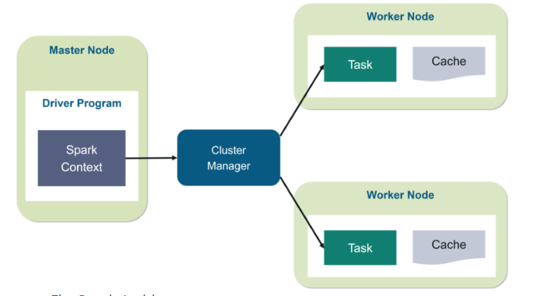
Apache Spark – Architecture

Slide 4
Apache Spark – Architecture in detail
Client submits the code to the driver, which will be converted into a DAG.
The submitted DAG will be converted into a series of stages which in turn gets converted into series of tasks by the driver and kept ready.
The Driver will negotiate with the cluster manager for resources. Now the cluster manager will launch the executors in worker nodes on behalf of the driver.
Driver will now send the tasks to the corresponding worker nodes based on the data it contains.
Now the executors have to register themselves with the driver before starting to execute the tasks, by this the driver can have a complete monitoring of all the executors.

Slide 5
Apache Spark
Property | Hadoop | Spark(PySpark/Scala)
Architecture | Map Reduce | YARN(Yet Another Resource Negotiator)
Speed | Faster than traditional cluster systems | 100X times than MapReduce
Data Processing | Batch | Real time processing
Caching | Doesn’t support caching of data | Catches the data in memory and therefore enhances the performance.
Written in | Java | Scala

Slide 6
Apache Spark – Pros and Cons
Pros
Easy to Program and not much coding involved.
Increased processing power because of in-memory processing
Batch and Near real time processing.
Executes jobs 10 to 100X faster than Map reduce
Rich features like RDD,Dataframe,Streaming etc.

Slide 7
Apache Spark – Pros and Cons
Cons
Supports only near real time processing and not full real time processing, as the streamed data will be processed in intervals.
Not much suitable for large number of small sized files
No inbuilt file management system
Expensive because of in-mem processing
Iterative processing(Processed in batches)

Slide 8
Spark in different modes
Spark as standalone – Can be launched manually using scripts by starting the master and the workers. This mode is mainly used for development and testing.
Spark on mesos –Mesos, as a cluster manager, provides its own extra features like dynamic and scalable partitioning to the spark.
Spark on YARN – Provides all the parallel processing capabilities on spark.
Spark on EC2 (Elastic Compute Cloud)– Provides key,value pair benefits on Amazon.

Slide 9
Apache Spark – Resilient Distributed Data
val a = sc.textFile(a.txt)
val b = a.map(filter values less than 10)
File.txt
1,30,45,6
23,39,2,7
=======
20,78,3,9
89,1,4,5
=======
9,20,13,7
90,2,9,34
78,5,8,10
SC
DN1
DN2
DN3
B1 -> B4
B2 -> B5
B3 -> B6
B1
B2
B3

Slide 10
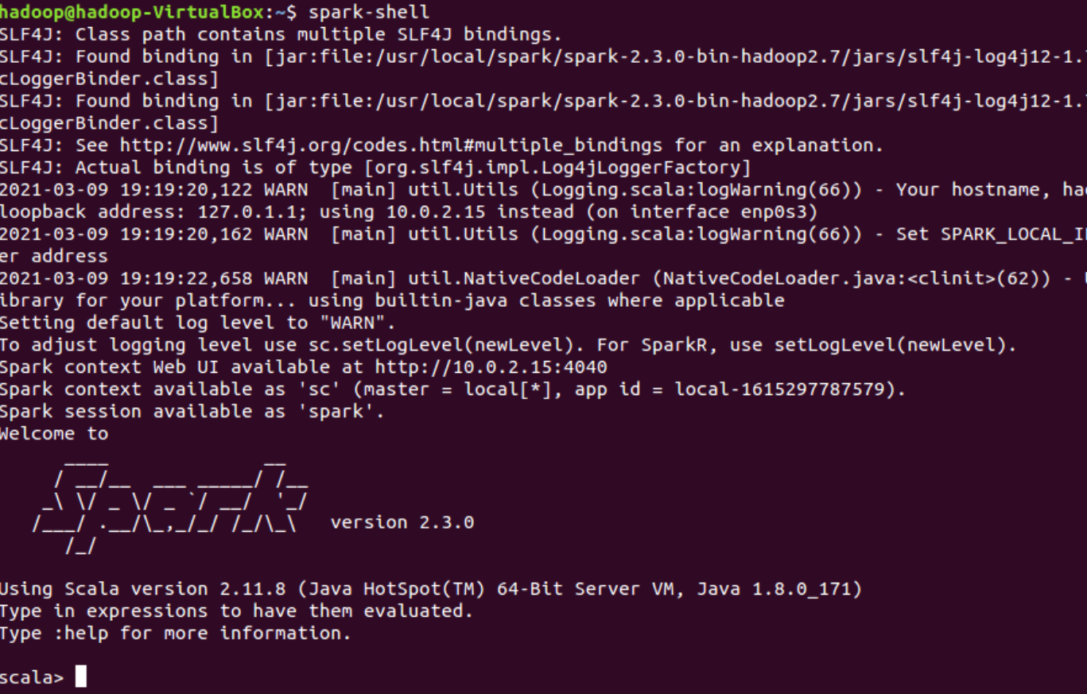
Spark-shell

Slide 11
Apache Spark – Resilient Distributed Data
Spark follows lazy evaluation engine, once the action command is performed then only the data will be brought to the memory.
To login into spark with Scala
$spark-shell
Then you will enter into
Scala>
To login into spark with python
$pyspark
>>>

Slide 12
Lineage
All transformation steps are brought into memory, once we hit the action command(collect/take()).
top.
RDD a
RDD d
RDD b
RDD e
d.collect
RDD c
e.collect
c.collect

Slide 13
Persisting RDD
When a data needs to be persistent?
When a data set is likely to be reused like in iterative algorithms.
How to choose a persistent level?
Memory only (only when required and have enough space in memory)
Disk (Re-computation is more expensive than disk read)
Replication (Re-computation is more expensive than memory)

Slide 14
Persisting RDD’s
Persisting an RDD saves the data (default in memory).
RDD.persist() or RDD.cache()
In-memory Persistence is a suggestion to spark.
If not enough memory is available , persisted partitions will be cleared from memory.
Least recently used partitions will be cleared first (LRU algorithm)
Whether a RDD is persistent or not , if a new RDD comes and need space, then based on the LRU algorithm, the older RDD will be deleted.

Slide 15
Persisting RDD’s
The place where the persistent RDD can be stored is configurable.
The different options where it can be stored are ,
MEMORY_ONLY (default) – same as cache
MEMORY_AND _DISK – store partitions in disk if they not fit into memory. (spilling)
DISK_ONLY (store all partitions on disk)
Scala>import org.apache.spark.storage.StorageLevel
Scala>myrdd.persist(StorageLevel.DISK_ONLY)

Slide 16
Apache Spark SQL - DataFrames
Spark module for structured data processing.
Replaces shark(a prior spark module, now deprecated)
Built on top of core spark
Provides
DataFrame API – a library for working with data as tables.
SQL engine and command line interface
Metastore will be shared by spark SQL,Hive and Impala.

Slide 17
Apache Spark SQL - DataFrames
Convert an RDD to Dataframe, provided it has a schema in it.
Rdd.toDF(“schema”)
The Dataframe can also be converted into a temporary table, so that you can start writing queries to process it.
Rdd.registerTempTable(“..”)
Using the SQLContext object then we can start writing queries on top of it.

Slide 18
Apache Spark SQL - DataFrames
Lets do some spark-sql exercises.

Slide 19
Knowledge check
What is the default storage for RDD persistence?
Can a un-persisted RDD be replicated?
What is LRU?

